Slide 1

Understanding road accidents outcomes
Clement Galvier – General Assembly DSIF-6
Notes:
Why this project

Slide 2






Problem statement
Can we extract key accident features to protect road users
Our data (tabular format from https://www.data.gouv.fr/)
360k records x 58 features
Locations
Vehicles
People
Extra Info

Slide 3
Definitions
Survival: anyone with no or minor injury
Driver: anyone driving any vehicle (car, bicycle, PMD)
Passenger: anyone on the same vehicle as the driver
Pedestrian: anyone else involved in a road accident

Slide 4




The road ahead
Part 1
Finding survival factors through EDA
Part 2
Building a model able to predict survival outcomes
Aggregate data
EDA
Modeling
Data storage
Notes:
SQLite
CREATE TABLES
INSERT INTO
Multi-level JOINS
Powerbi
DAX
PowerQuery
Modeling
Features engineering
Feature selection
Modeling + scoring

Slide 5
EDA
Who is most involved in accidents
Notes:
SQLite
CREATE TABLES
INSERT INTO
Multi-level JOINS
Powerbi
DAX
PowerQuery
Modeling
Features engineering
Feature selection
Modeling + scoring

Slide 6
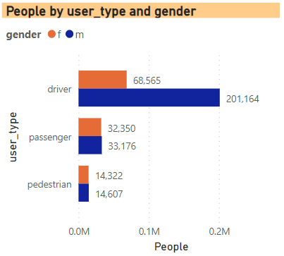
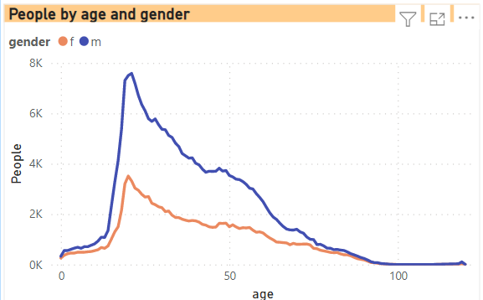
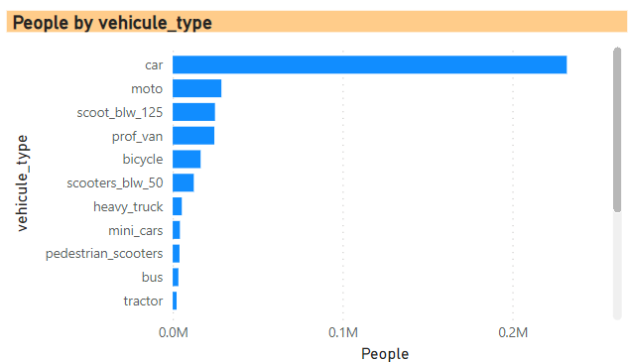


EDA – who’s involved in accidents
Male drivers
(rather young)
In a car
(2019-2021)

Slide 7
EDA
Drivers
Notes:
SQLite
CREATE TABLES
INSERT INTO
Multi-level JOINS
Powerbi
DAX
PowerQuery
Modeling
Features engineering
Feature selection
Modeling + scoring

Slide 8
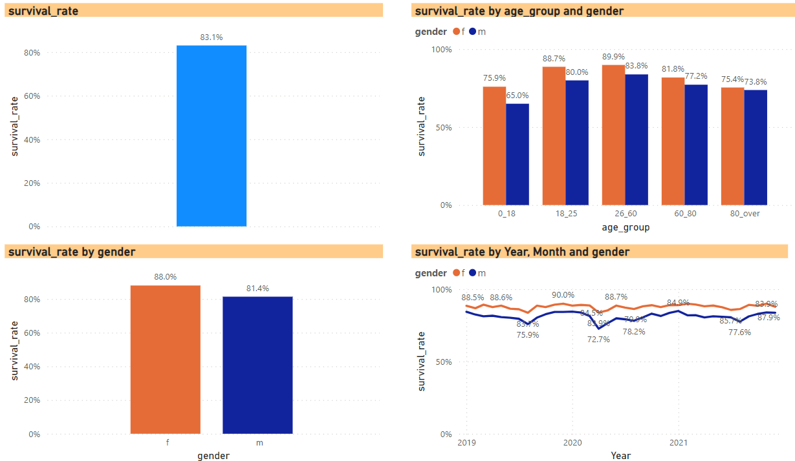
Drivers – Survival rate

Slide 9
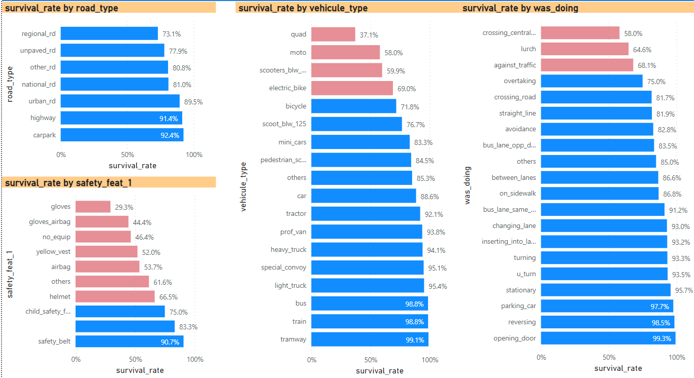
Drivers – survival rate

Slide 10

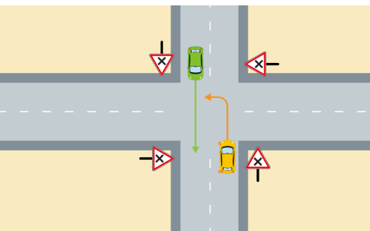
Drivers – survival rate
Bi-directional roads – turning left (“crossing central “)

Slide 11
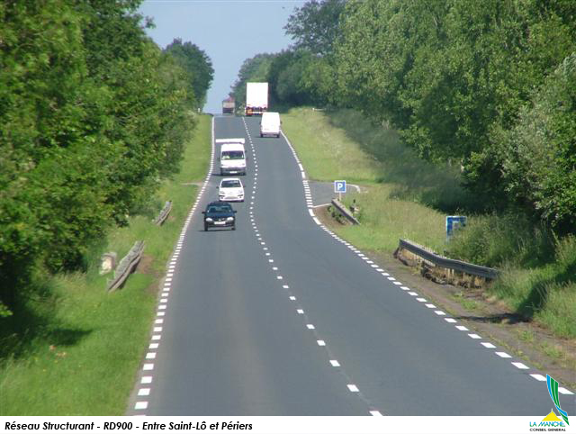
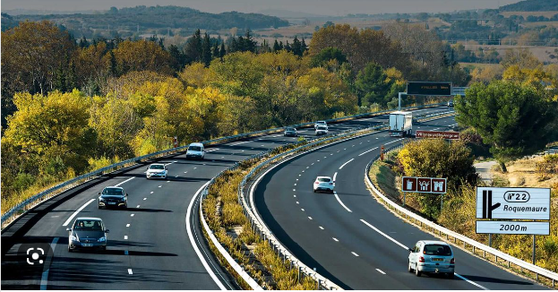
Drivers – survival rate
Regional roads
Highways
1. High speed (90-110km/h)
2. No safety feature
3. Bi-directional with no separation
1. 110-130km/h
2. Safety features
3. Bi-directional with separation

Slide 12
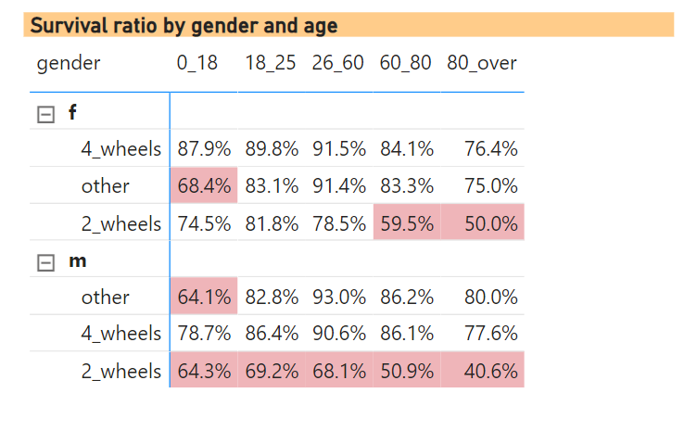

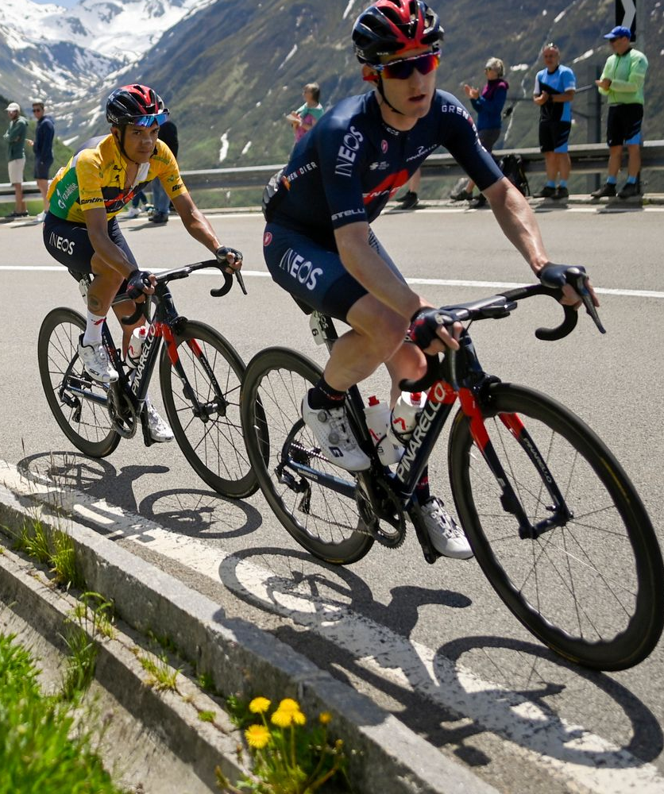

Drivers – the 2 wheels problem
Highlighted survival <70%

Slide 13
EDA
Pedestrians
Notes:
SQLite
CREATE TABLES
INSERT INTO
Multi-level JOINS
Powerbi
DAX
PowerQuery
Modeling
Features engineering
Feature selection
Modeling + scoring

Slide 14
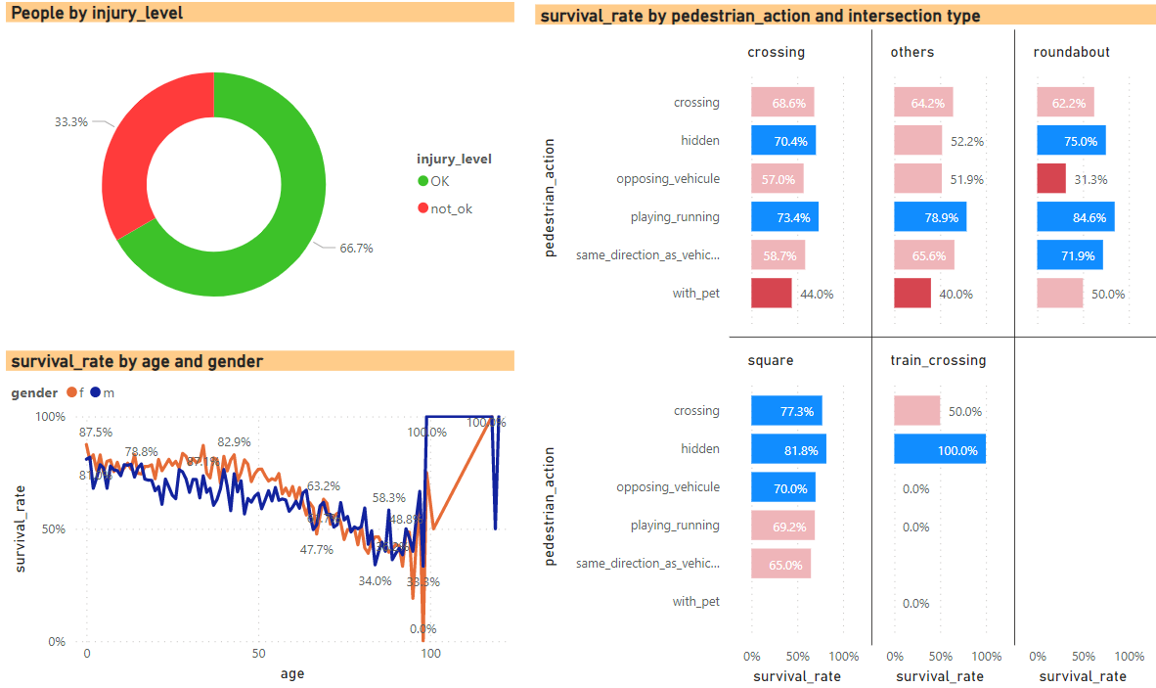
Pedestrians – survival rate

Slide 15
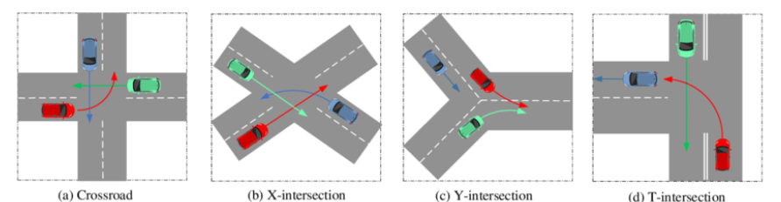
Pedestrians – survival rate
Types of crossing

Slide 16
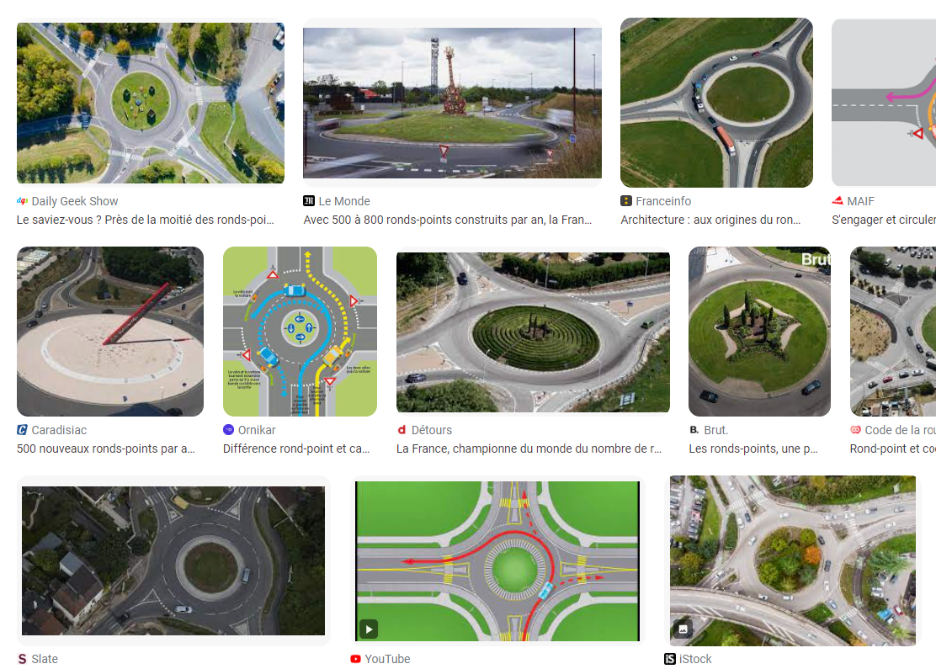
Pedestrians – survival rate
France, roundabouts world champion
30’000

Slide 17
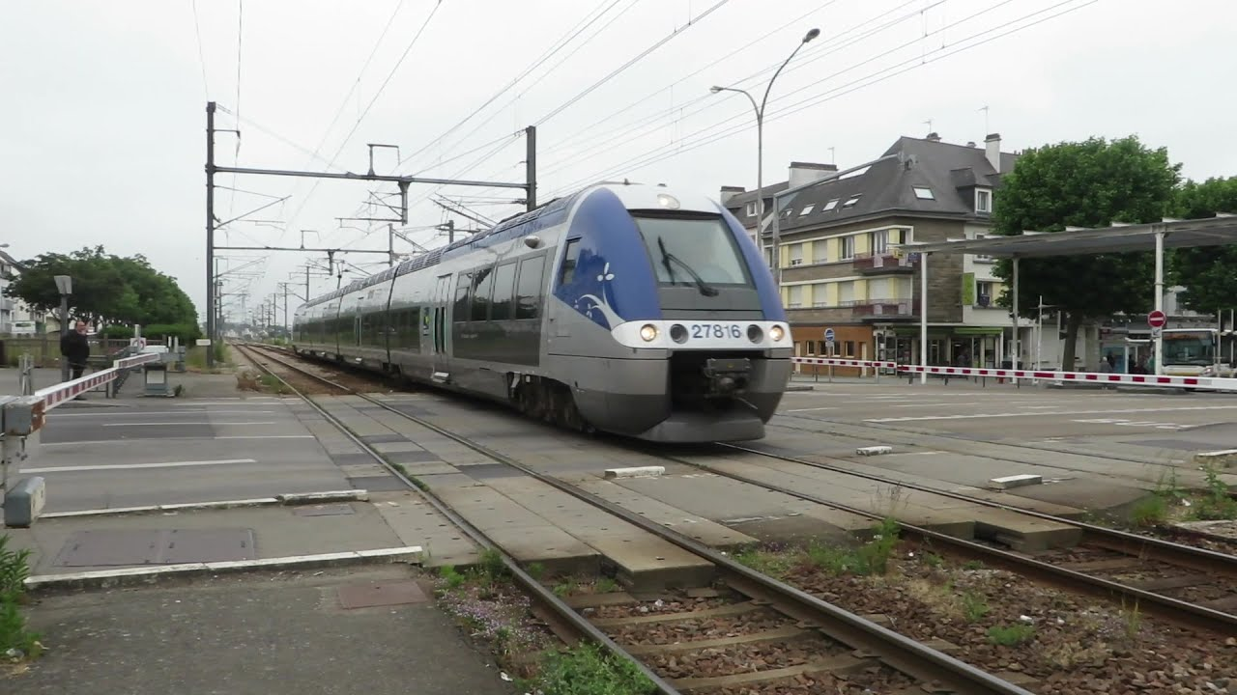
Pedestrians – survival rate
Bi-directional train crossing
15’000
Each year
100 collisions
20 deaths

Slide 18
Modeling
Notes:
SQLite
CREATE TABLES
INSERT INTO
Multi-level JOINS
Powerbi
DAX
PowerQuery
Modeling
Features engineering
Feature selection
Modeling + scoring

Slide 19
Models chosen
Logistic Regression
Predict proba which is then forced into 0 or 1
Ada Boost
Retraining the misclassified samples
Support Vectors Classifier
Maximal margin + soft margin + kernel to classify datapoints
XG Boost
Gradient Descent + Boosting
Notes:
https://blog.paperspace.com/adaboost-optimizer/#:~:text=AdaBoost%20is%20an%20ensemble%20learning,turn%20them%20into%20strong%20ones.
Key words
Logisitc regression loss function = binary cross entropy
SVC
Ada boost

Slide 20
Models chosen – pros and cons
Logistic Regression
Pros
- Fast to implement and easy to interpret
- Often performing better than more complex algorithms
Cons
- Assumes linear relationship
Ada Boost
Pros
- Not many parameters to tune
- Can work with SVC
Cons
- Sensitive to noise
Support Vectors
Pros
- Works well with many features
Cons
- Slow to train (requires small dataset)
XG Boost
Pros
- Fast to fit
- In-built capability to handle missing values
Cons
- Easily overfit
- Hard to tune

Slide 21
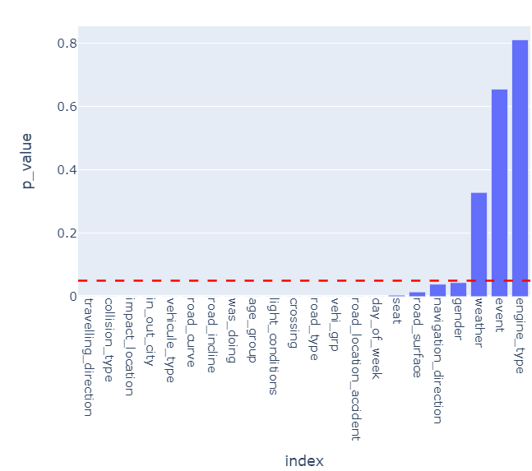
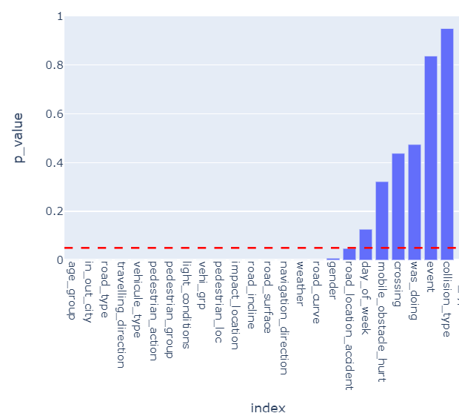
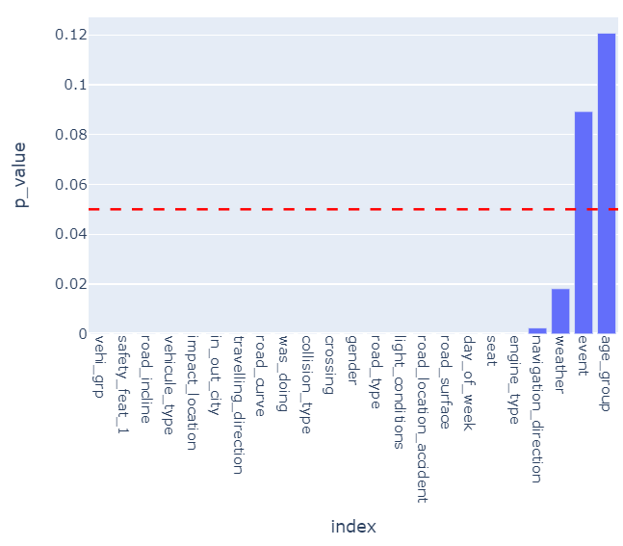
Features selection
Passengers
Pedestrians
Drivers
Remove
Engine type
Public Holidays
Weather
Remove
Collision type
Public holidays
Crossing
Day of the week
Remove
Age group
Public holidays

Slide 22
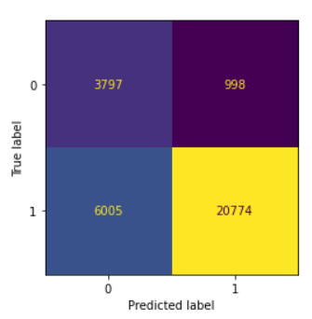
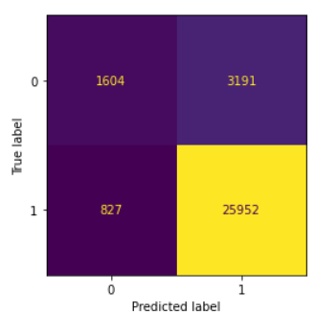
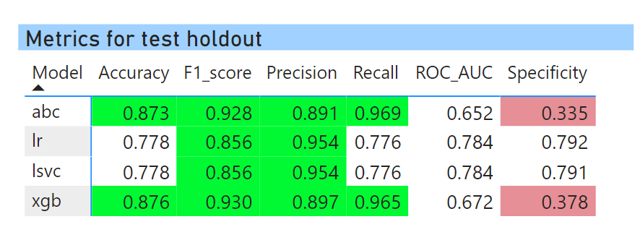
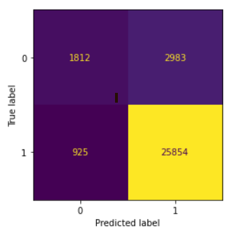
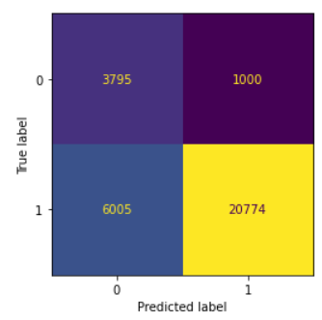
Results (drivers)
LR
ADA
Baseline accuracy
83.3%
XGB
LSVC

Slide 23
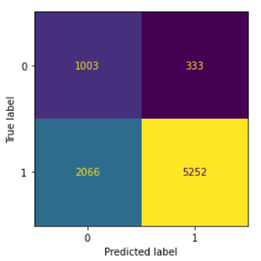
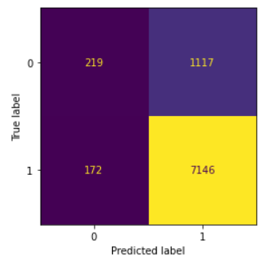
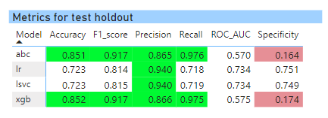
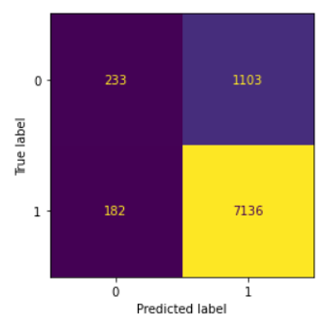
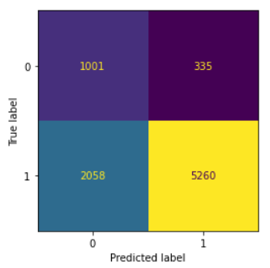
Results (passengers)
LR
ADA
Baseline accuracy
83.4%
XGB
LSVC

Slide 24
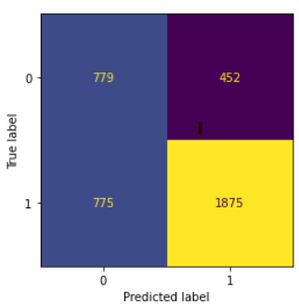
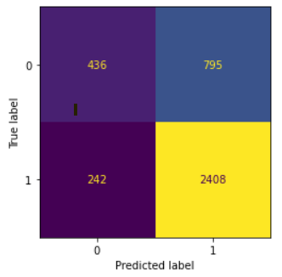
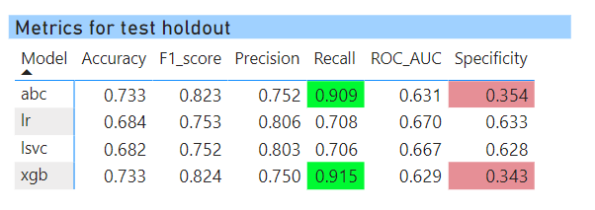
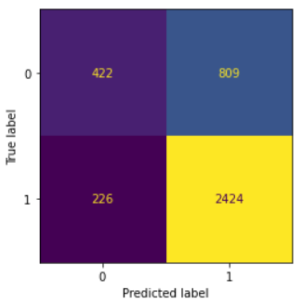
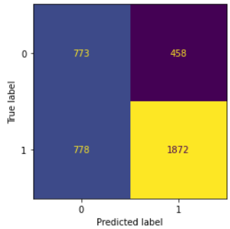
Results (pedestrians)
LR
ADA
Baseline accuracy
66.7%
XGB
LSVC

Slide 25
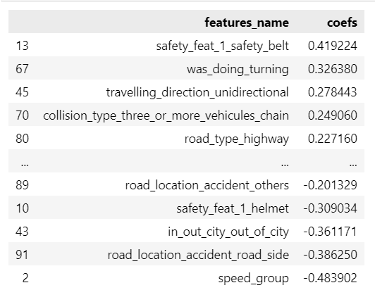
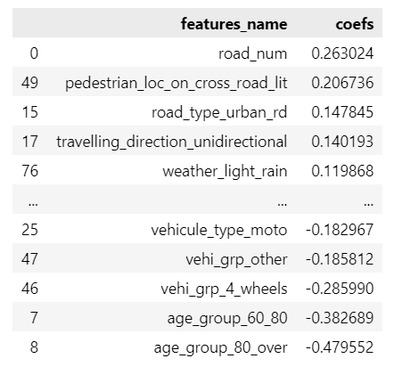
Features importance (L. Regression)
Drivers
Pedestrians

Slide 26
Conclusions
Regional roads are more deadly (with more speed allowed and less safety features)
Pedestrians survive less
18-25yo are more involved in accidents
Who? | Drivers | Passengers | Pedestrians
Public policies | Speed limits (in and out of cities) Develop affordable and reliable public transport Extending driving license probation period Develop safe cycling paths |  | Protective features: longer wait time at crossings, road delimiters (pavement/ local parks)
Police | Policy enforcement Education from JC until University | Policy enforcement | Support high traffic zones
Communication/ Education | Targeted posts on social media (18-25) Targeted ads during Tour de France (60+) |  | Schools involved in teaching how to behave with vehicles around

Slide 27
Future works
Modeling
- More param tuning
- More models tried (#pycaret)
- Try different feature engineering (groupings)
Collect more info
More years of data
Drivers blood tests (drugs/alcohol/meds …)
Vehicle conditions (tires, breaks, headlights…)

Slide 28


Slide 29
Appendixes SQL
1. SQLite and Python
https://stackoverflow.com/questions/54289555/how-do-i-execute-an-sqlite-script-from-within-python
2. Creating tables in SQLite
https://www.techonthenet.com/sqlite/tables/create_table_as.php
3. Storing results
https://stackoverflow.com/questions/41317769/how-can-i-store-a-join-query-as-a-new-table-in-sqlite
4. Multiple joins:
https://learnsql.com/blog/sql-join-tables-by-multiple-columns/
5. Duplicates when using multiple joins:
https://stackoverflow.com/questions/23786401/why-do-multiple-table-joins-produce-duplicate-rows
6. Types of joins in SQLite
https://www.sqlite.org/lang_select.html
7. very good article – hand holding
https://towardsdatascience.com/an-easy-beginners-guide-to-sqlite-in-python-and-pandas-fbf1f38f6800

Slide 30
Font: Century
Title: 50
Important: 40
Text: 30

